Slide 1


Graphics
Images within 2D games
Part 2 – Alpha Blending

Slide 2

Alpha Compositing

Slide 3



Alpha blending (more generally Alpha Compositing) determines how two images are combined to produce a single composite image.
The most common way of combining a source image (what you want to draw) with a destination image (what is already there) is as follows:
1 | outputColour = sourceColour * sourceBlend
2 | + destinationColour * destinationBlend
Each channel (red, green, blue, alpha) is separately blended.

Slide 4
Alpha blending (blend functions)
Zero
Each component of the colour is multiplied by (0, 0, 0, 0).
One
Each component of the colour is multiplied by (1, 1, 1, 1).
SourceColor
Each component of the colour is multiplied by the source colour, i.e. (R_{s}, G_{s}, B_{s}, A_{s}).
Each component of the colour is multiplied by the alpha value of the destination, i.e. (A_{d}, A_{d}, A_{d}, A_{d})
SourceAlpha
Each component of the colour is multiplied by the alpha value of the source, i.e. (A_{s}, A_{s}, A_{s}, A_{s}).
DestinationColor
Each component colour is multiplied by the destination colour, i.e. (R_{d}, G_{d}, B_{d}, A_{d}).
DestinationAlpha
A wide range of different blend functions are defined, including those shown:
Inverse functions are also defined, e.g. InverseSourceAlpha

Slide 5
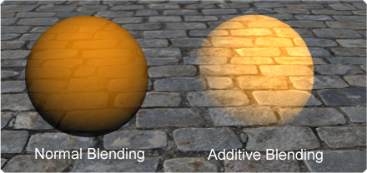
How do we want to combine images?
In 2D games there are two common ways in which images are combined...
‘Normal’ alpha blending: Drawing a transparent or translucent image so that it shows what is underneath.
Additive blending: Adding an image to the existing image (brightening some regions).

Slide 6
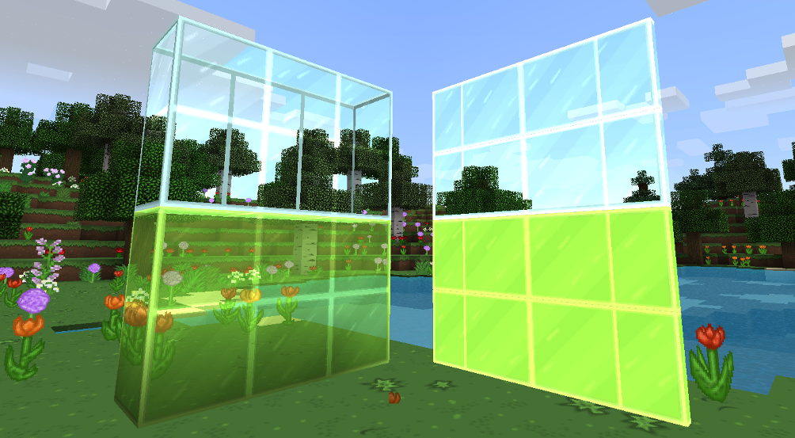
Alpha Blending

Slide 7
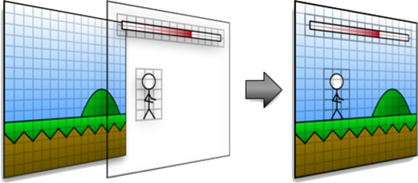
1 | colour = sourceColour * sourceAlpha
2 | + destinationColour * inverseSourceAlpha
The combination of blend functions that provides ‘normal’ alpha blending, i.e. enabling translucency, is shown opposite.
As SourceAlpha increases, SourceColour dominates, and DestinationColour reduces.
Source Alpha | Src | Dest | Output
1.0 | S * 1.0 | D * 0.0 | S
0.0 | S * 0.0 | D * 1.0 | D
0.5 | S * 0.5 | D * 0.5 | (S+D)*0.5

Slide 8
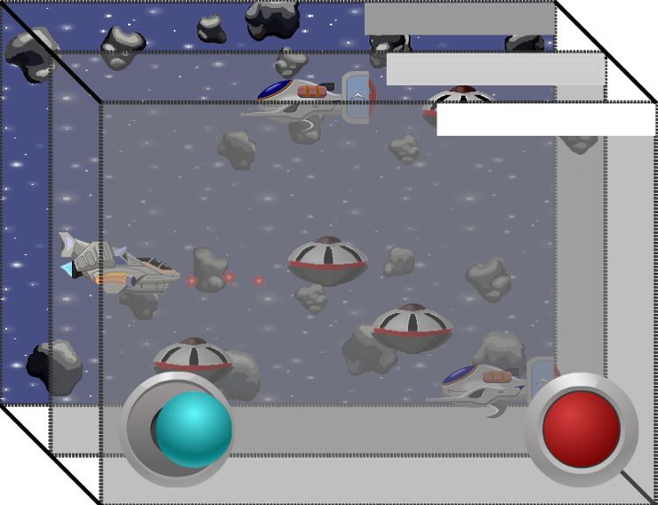
: Drawing in the Right Order
The order in which images are combined is important. Images that are ‘behind’ a transparent image must be drawn first before the transparent image is drawn.
The yellow square is above the blue square on the left and behind on the right:

Slide 9

Additive Blending

Slide 10
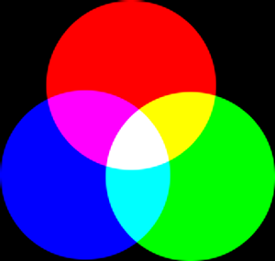
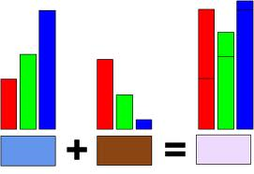
A less common, but popular, means of alpha blending is additive blending:
1 | colour = sourceColour * sourceAlpha
2 | + destinationColour * one
Additive blending is commutative, i.e. it does not matter the order in which images are combined, the end result is the same.
Using this form of blending there is no need to sort by depth order when combining images (although it can be more difficult to ‘visualise’ the output).

Slide 11
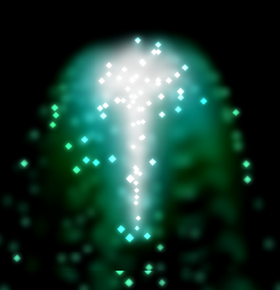
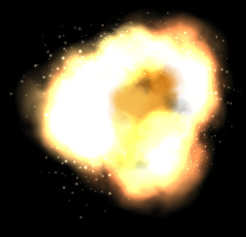
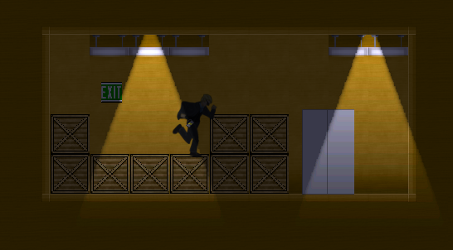
Additive blending is often used for particle effects and to provide ‘cheap’ and simple lighting in 2D games.

Slide 12

Key takeaways:
Alpha compositing involves drawing a source image on top of a background image.
Normal alpha blending provides a means of transparent or translucent combination.
Additive blending can be used to provide lighting effects.

